Slide 1
Project Presentation of Co-Op Project at Industry
On
Mental Health and its Impact on Public Productivity
Khushi Bansal , Goransh Handa and Aryan Sharma
Department of Computer Science and Engineering
Supervised By
Dr. Gurpreet Singh, Department of Computer Science and Engineering, Chitkara University
Department of Computer Science and Engineering,
Chitkara University, Punjab

Slide 2
Introduction & Objective
Mental health is a critical factor influencing productivity in academic and professional settings
Includes conditions like stress, anxiety, depression, and burnout
Affects cognitive abilities such as focus, memory, and decision-making
Poor mental health leads to reduced efficiency, motivation, and engagement
Objective:
To analyze the relationship between mental health and productivity
To understand how psychological well-being impacts performance
To highlight the need for maintaining mental health for sustainable productivity
2

Slide 3
Methodology
Uses secondary data from peer-reviewed journals and research
papers
Around 15 relevant studies analyzed
Data sources include academic publications and scholarly databases
Methods used:
Comparative analysis of different studies
Thematic analysis to identify common patterns
Focus on:
Research objectives, findings, and limitations of each study
Research based on a qualitative, literature review approach
Identification of research gaps for future improvements
3

Slide 4
Key Findings (1/2)
.
Mental health strongly influences individual
productivity levels
Stress and anxiety reduce:
Attention span
Memory retention
Decision-making ability
Burnout leads to:
Emotional exhaustion
Reduced motivation and engagement
4

Slide 5
Key Findings (2/2)
Poor mental health affects both:
Individual performance
Team collaboration and communication
Supportive environments (low stress, good communication) improve productivity
Digital tools can:
Enhance productivity when used properly
Increase anxiety if overused or relied on excessively
5

Slide 6
Conclusion
Strong relationship exists between mental health and productivity
Psychological well-being directly impacts cognitive and emotional functioning
Poor mental health leads to:
Low performance
Increased absenteeism
Reduced work quality
Good mental health promotes:
Better focus and creativity
Higher engagement and efficiency
Organizations and institutions must:
mental health awareness
Provide supportive environments and resources
6

Slide 7
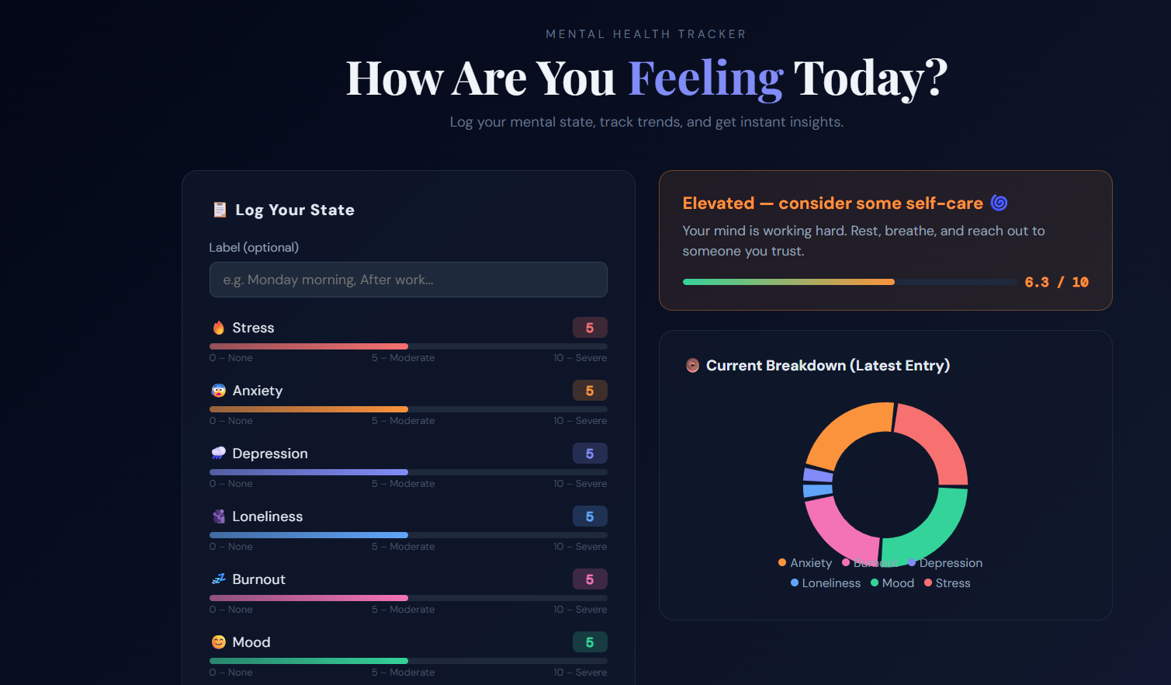
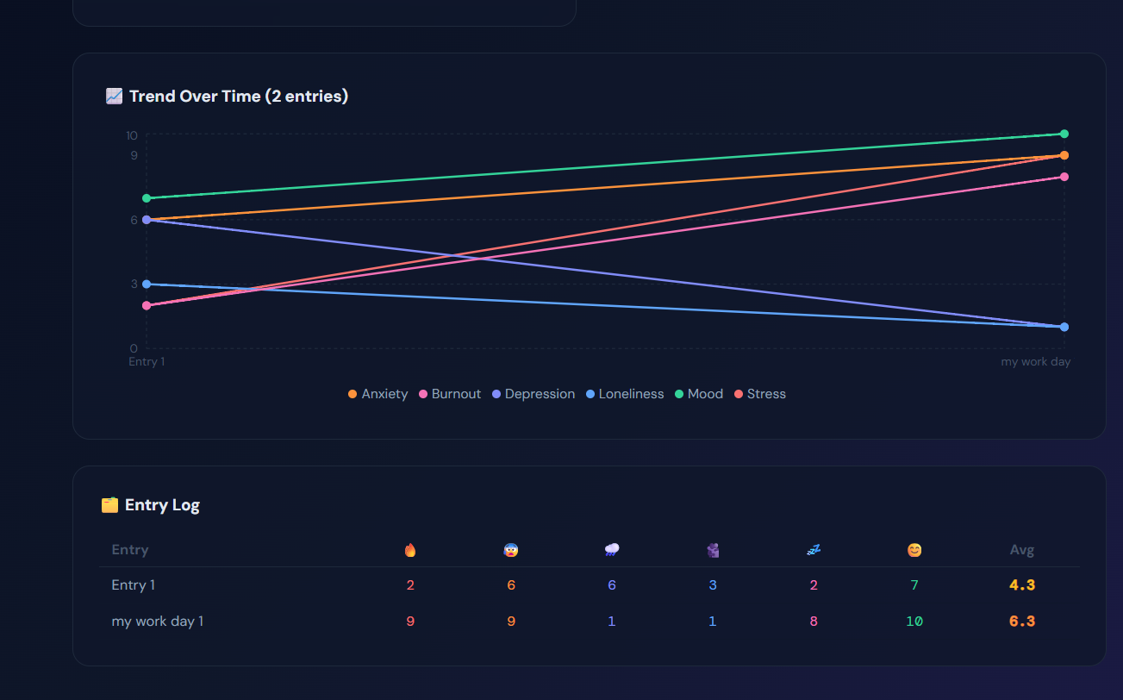
Snapshots

Slide 8
Future Scope
Conduct longitudinal studies to understand long-term effects
diverse populations (different cultures, professions, age groups)
Study evolving impact of digital technologies and remote work
Evaluate effectiveness of:
Counseling programs
Stress management techniques
Mental health intervention Includes
Develop better policies and workplace strategies
Encourage interdisciplinary research combining psychology, data science, and management
8

Slide 9
References
[1] R. C. Kessler, P. E. Greenberg, K. D. Mickelson, L. M. Meneades, and P. S. Wang, “The effects of chronic medical conditions on work loss and productivity,” Journal of Occupational and Environmental Medicine, vol. 43, no. 3, pp. 218–225, 2001.
[2] C. Maslach and S. E. Jackson, “The measurement of experienced burnout,” Journal of Occupational Behavior, vol. 2, no. 2, pp. 99–113, 1981.
[3] A. B. Bakker and E. Demerouti, “The Job Demands–Resources model: State of the art,” Journal of Managerial Psychology, vol. 22, no. 3, pp. 309–328, 2007.
[4] W. B. Schaufeli, M. Salanova, V. González‑Romá, and A. B. Bakker, “The measurement of engagement and burnout,” Journal of Happiness Studies, vol. 3, no. 1, pp. 71–92, 2002.
[5] E. L. Deci and R. M. Ryan, “The ‘what’ and ‘why’ of goal pursuits: Human needs and the self‑determination of behavior,” Psychological Inquiry, vol. 11, no. 4, pp. 227–268, 2000.
[6] R. S. Lazarus and S. Folkman, Stress, Appraisal, and Coping. New York, NY, USA: Springer, 1984.
[7] H. W. Marsh and R. G. Craven, “Reciprocal effects of self‑concept and performance,” Perspectives on Psychological Science, vol. 1, no. 2, pp. 133–163, 2006.
[8] C. L. Cooper and S. Cartwright, “Healthy mind; healthy organization,” Human Relations, vol. 47, no. 4, pp. 455–471, 1994.
[9] D. Goleman, Emotional Intelligence: Why It Can Matter More Than IQ. New York, NY, USA: Bantam Books, 1995.
[10] T. M. Amabile, Creativity in Context. Boulder, CO, USA: Westview Press, 1996.

Slide 10
Thank You
10

